Slide 1






Learn contexts
for A,B,C,D
Link new contextual cues to contexts
for B,C,D (A is never presented)
Novel situation
Context 1 |  |  |  |  | Context 2 |  |  |  |  | Context 1 |  |  |  | Context 2 |  |  |  | Context 1 |  |  |  |  | A
A | C | D | B |  | D | A | B | C |  | C | B | D |  | D | C | B |  | B | C | D
 |  |  |  | … |  |  |  |  | … |  |  |  | … |  |  |  | … |  |  |  | …
↑ | ↓ | ← | → |  | ↑ | → | ↓ | ← |  | ↓ | → | ← |  | ↑ | ← | ↓ |  | → | ↓ | ← |  |  | ↑ | →
LR | SR | LR | SR |  | LR | SR | SR | LR |  | SR | SR | LR |  | LR | LR | SR |  | SR | SR | LR |  |  | LR | SR
50%
50%

Slide 2
Learn contexts
for A,B,C,D
Link new contextual cues to contexts
for A,B,C (D is never presented)
Novel situation
Context 1 |  |  |  |  | Context 2 |  |  |  |  | Context 1 |  |  |  | Context 2 |  |  |  | Context 1
A | C | D | B |  | D | A | B | C |  | C | B | A |  | A | C | B |  | B | C | A |  |  |  | D
 |  |  |  | … |  |  |  |  | … |  |  |  | … |  |  |  | … |  |  |  | … | ⚠️
↑ | ↓ | → | ← |  | ↓ | → | ↑ | ← |  | ↓ | ← | ↑ |  | → | ← | ↑ |  | ← | ↓ | ↑ |  |  |  | → | ↓
LR | SR | LR | SR |  | LR | SR | SR | LR |  | SR | SR | LR |  | SR | LR | SR |  | SR | SR | LR |  |  |  | LR | LR

Slide 3
a
C1 | C2 | C1 | C2 | C1 | C2
ABCD | ABCD | ABCD | ABCD | ABCD | ABCD
b
Ctx 1 |  |  | Ctx 2
S | R | O | S | R | O
A | ↑ | LR | A | → | SR
B | ← | SR | B | ↑ | SR
C | ↓ | SR | C | ← | LR
D | → | LR | D | ↓ | LR
Ctx 1 |  |  | Ctx 2
S | R | O | S | R | O
A | ↓ | LR | A | ← | SR
B | ← | SR | B | ↑ | SR
C | ↑ | SR | C | → | LR
D | → | LR | D | ↓ | LR

Slide 4
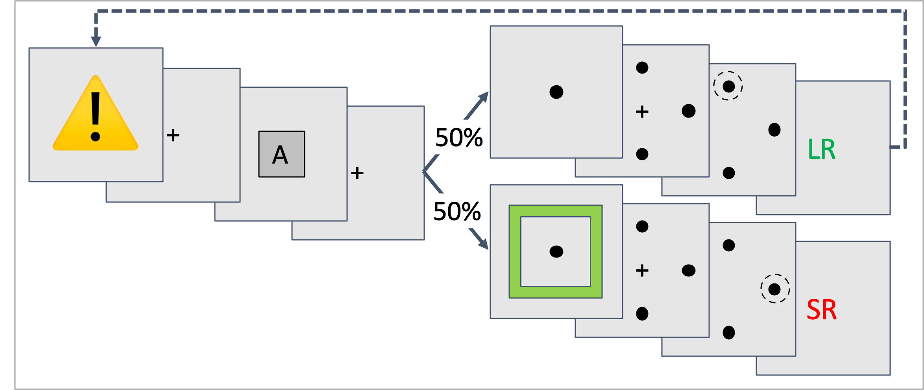
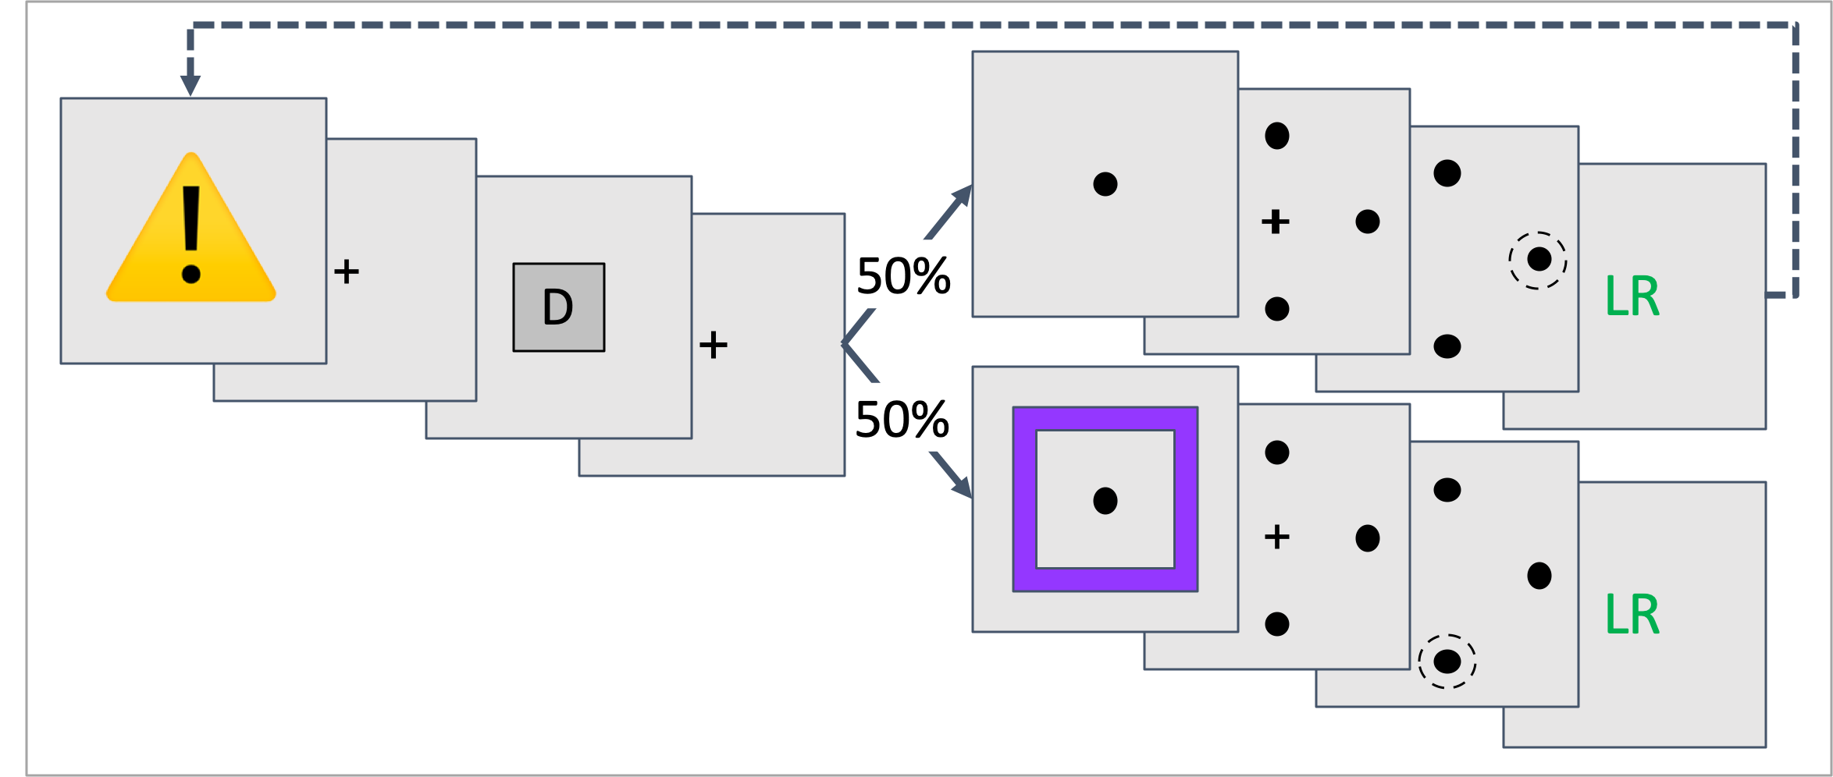
a
C1 | C2 | C1 | C2 | C1 | C2 | C1 | C2 | C1 |  | C2
ABCD | ABCD | ABCD | ABCD | ABC | ABC | ABC | ABC | D | ABCD | D | ABCD
b
Ctx 1 |  |  | Ctx 2
S | R | O | S | R | O
A | ↑ | LR | A | → | SR
B | ← | SR | B | ↑ | SR
C | ↓ | SR | C | ← | LR
D | → | LR | D | ↓ | LR
c
d
C1 → C2 : Flexibility Trials
C1 → C2 : Generalization Trials

Slide 5
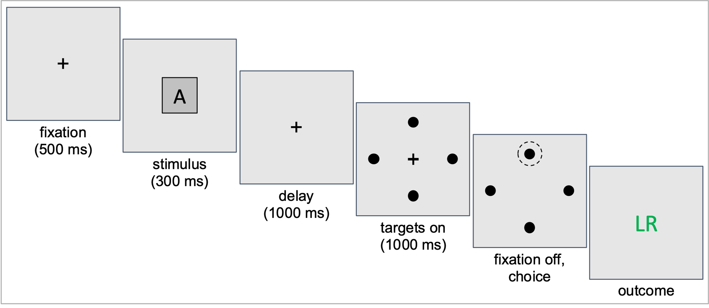
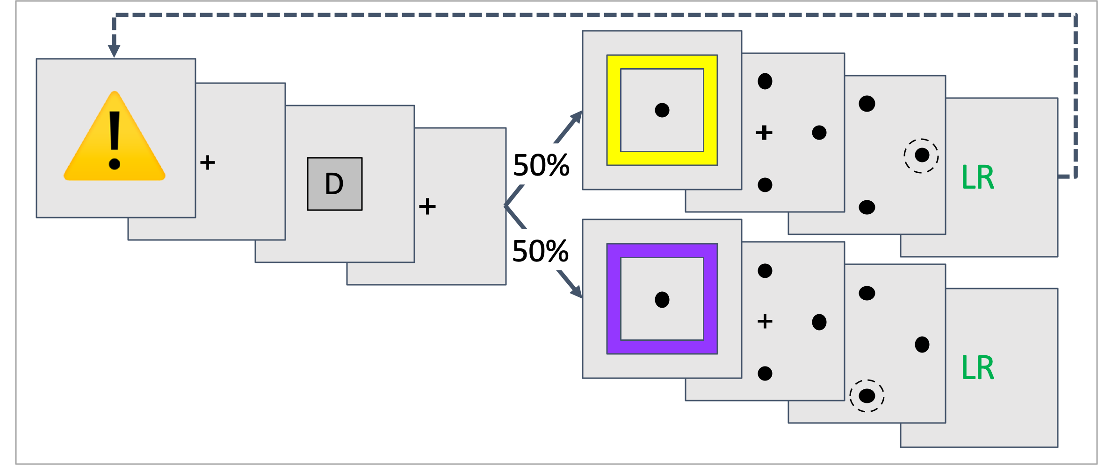
a
C1 | C2 | C1 | C2 | C1 | C2 | C1 | C2 | C1 |  | C2
ABCD | ABCD | ABCD | ABCD | ABC | ABC | ABC | ABC | D | ABCD | D | ABCD
b
Ctx 1 |  |  | Ctx 2
S | R | O | S | R | O
A | ↑ | LR | A | → | SR
B | ← | SR | B | ↑ | SR
C | ↓ | SR | C | ← | LR
D | → | LR | D | ↓ | LR
c
d
Trials Without Contextual Cue
C1 → C2 : Generalization Trials

Slide 6
a
C1 | C2 | C1 | C2 | C1 | C2 | C1 | C2 | C1 |  | C2
ABCD | ABCD | ABCD | ABCD | ABC | ABC | ABC | ABC | D | ABCD | D | ABCD
b
Ctx 1 |  |  | Ctx 2
S | R | O | S | R | O
A | ↑ | LR | A | → | SR
B | ← | SR | B | ↑ | SR
C | ↓ | SR | C | ← | LR
D | → | LR | D | ↓ | LR
c
d
Trials Without Contextual Cue
C1 → C2 : Flexibility Trials

Slide 7
A
fixation
(500 ms)
stimulus
(300 ms)
LR
delay
(1000 ms)
targets on
(1000 ms)
fixation off,
choice
outcome

Slide 8
⚠️
LR
50%
A
50%
SR

Slide 9
⚠️
LR
50%
D
50%
LR

Slide 10

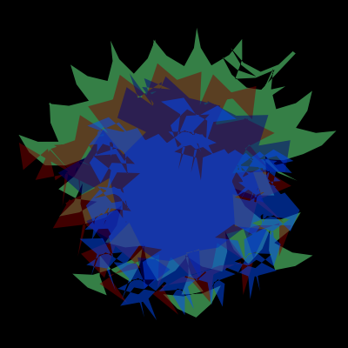
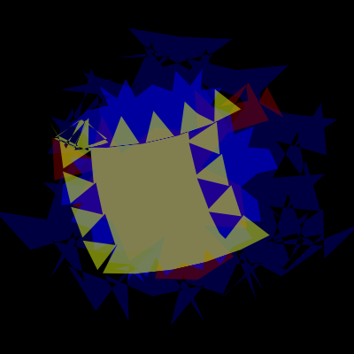
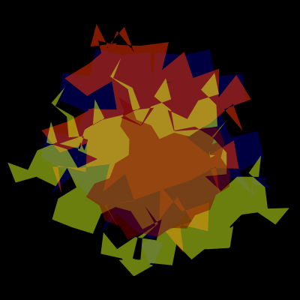
C1 | C2 | C1 | C2 | C1 | C2 | C1 | C2 | C1 |  | C2
ABCD | ABCD | ABCD | ABCD | ABC | ABC | ABC | ABC | D | ABCD | D | ABCD
Context 1 |  |  | Context 2
S | R | O | S | R | O
A | ↑ | L | A | → | S
B | → | L | B | ↓ | S
C | ↓ | S | C | ← | L
D | ← | S | D | ↑ | L
Ctx 1 |  |  | Ctx 2
S | R | O | S | R | O
A | ↑ | LR | A | → | SR
B | ← | SR | B | ↑ | SR
C | ↓ | SR | C | ← | LR
D | → | LR | D | ↓ | LR

Slide 11





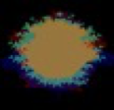


C1 | C2 | C1 | C2 | C1 | C2 | C1
ABCD | EFGH | ABCD | EFGH | ABCD | EFGH | ABCD
Ctx 1 |  |  | Ctx 2
S | R | O | S | R | O
A | ↑ | LR | E | → | SR
B | ← | SR | F | ↑ | SR
C | ↓ | SR | G | ← | LR
D | → | LR | H | ↓ | LR
A
LR

Slide 12
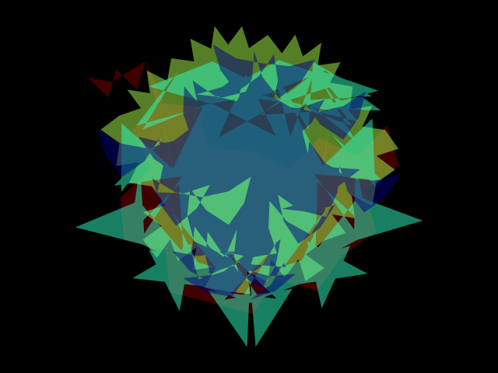
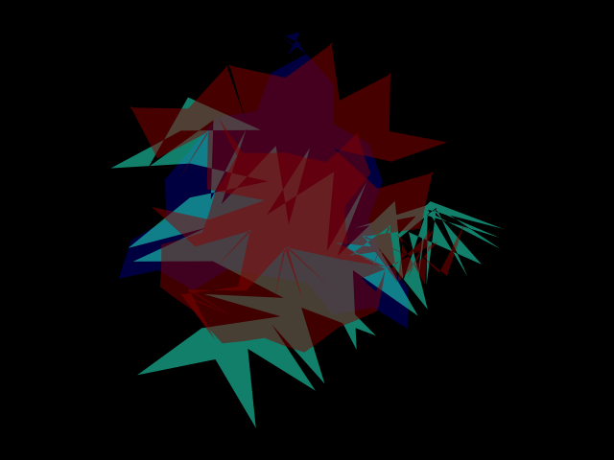

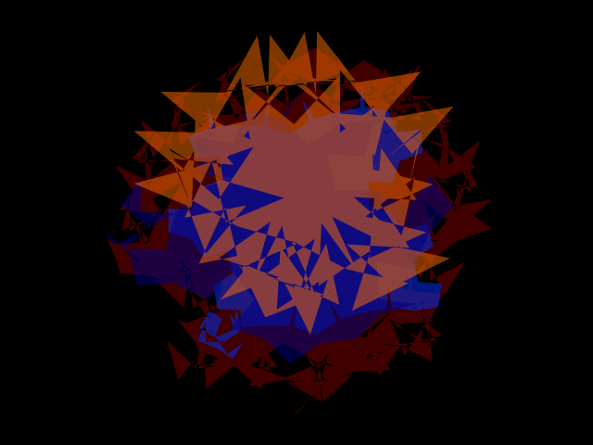
Set 1 |  |  | Set 2
S | R | O | S | R | O
A | ↑ | 💧 | A | → | 💧
B | → | 💧 | B | ↓ | 💧
C | ↓ | 💧 | C | ← | 💧
D | ← | 💧 | D | ↑ | 💧
Set 1 |  |  | Set 2
S | R | O | S | R | O
A | ↑ | LR | E | → | SR
B | ← | SR | F | ↑ | SR
C | ↓ | SR | G | ← | LR
D | → | LR | H | ↓ | LR

Slide 13
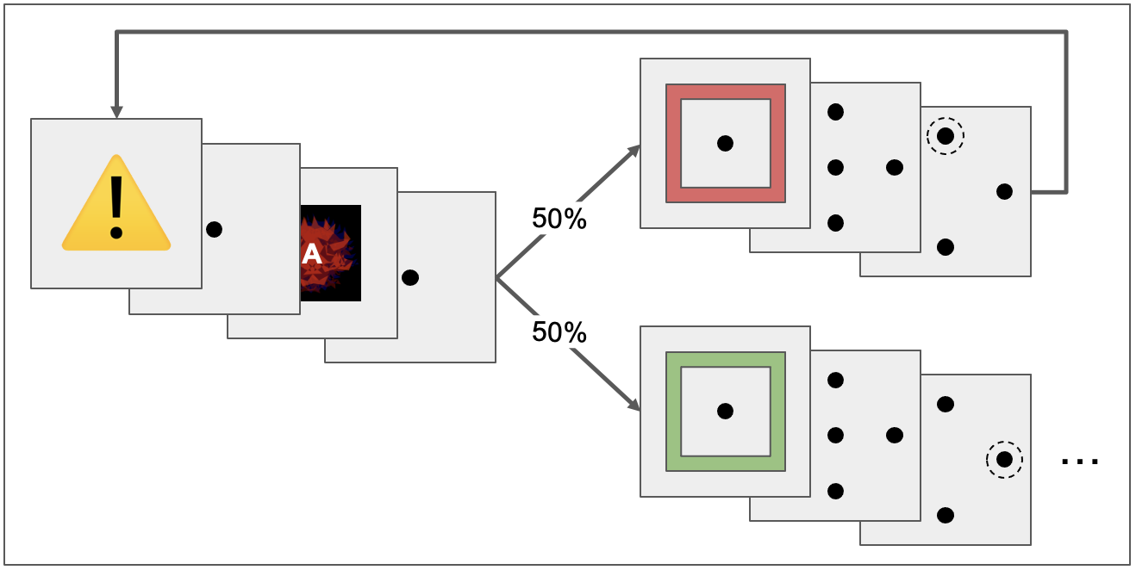
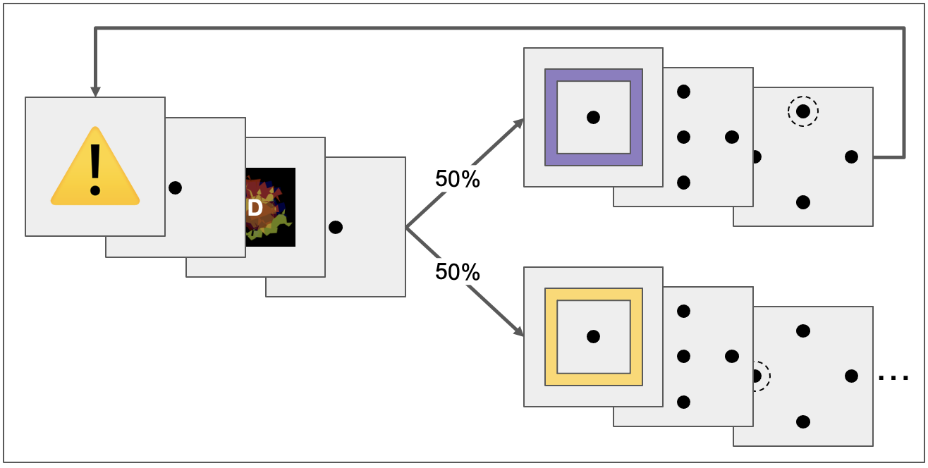
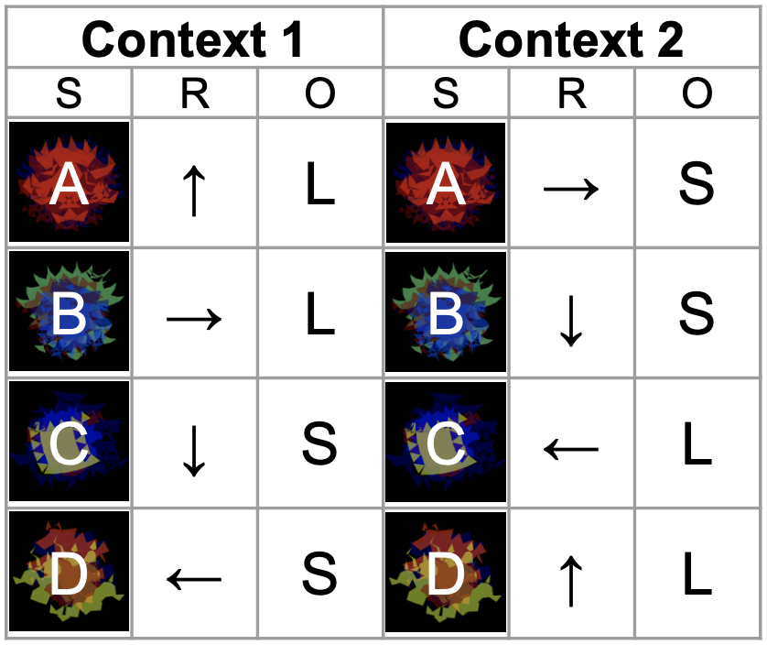
C1 | C2 | C1 | C2 | C1 | C2 | C1 | C2 | C1 |  | C2
ABCD | ABCD | ABCD | ABCD | ABC | ABC | ABC | ABC | D | ABCD | D | ABCD
Flexibility
Generalization

Slide 14
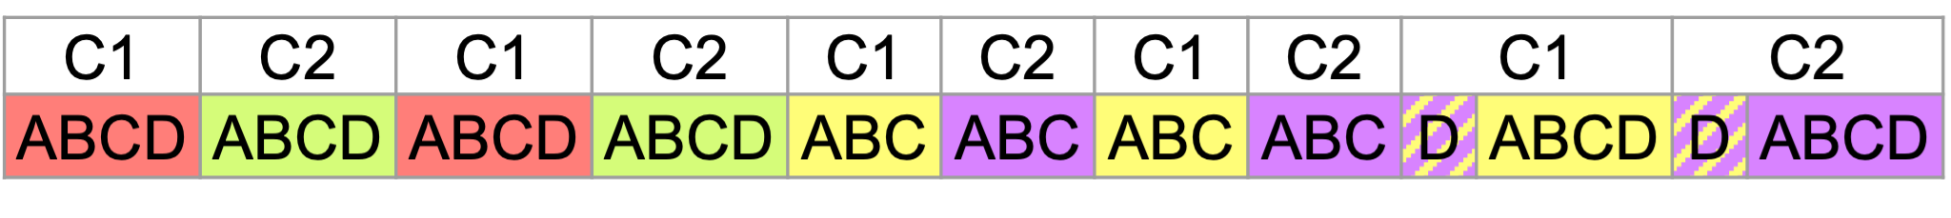
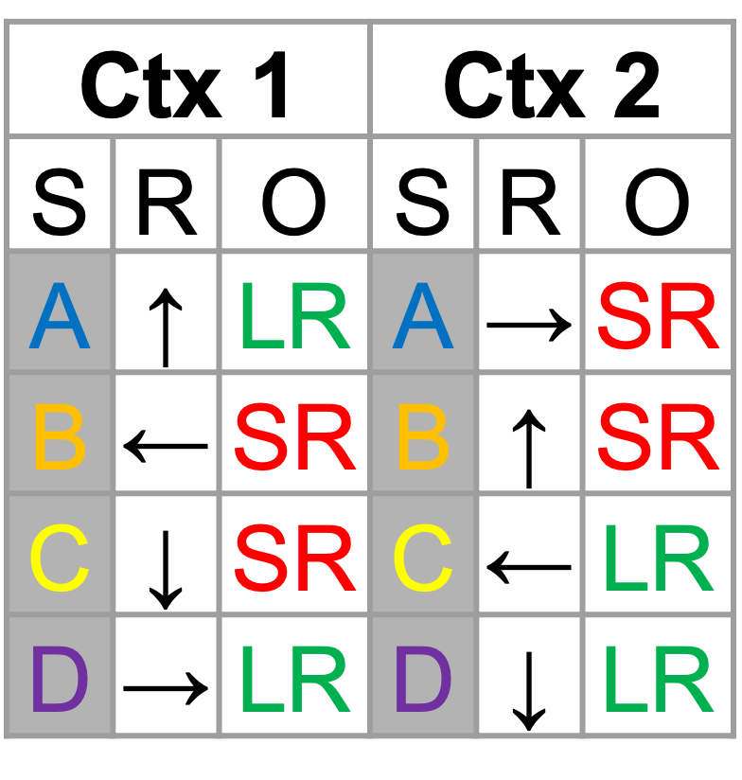
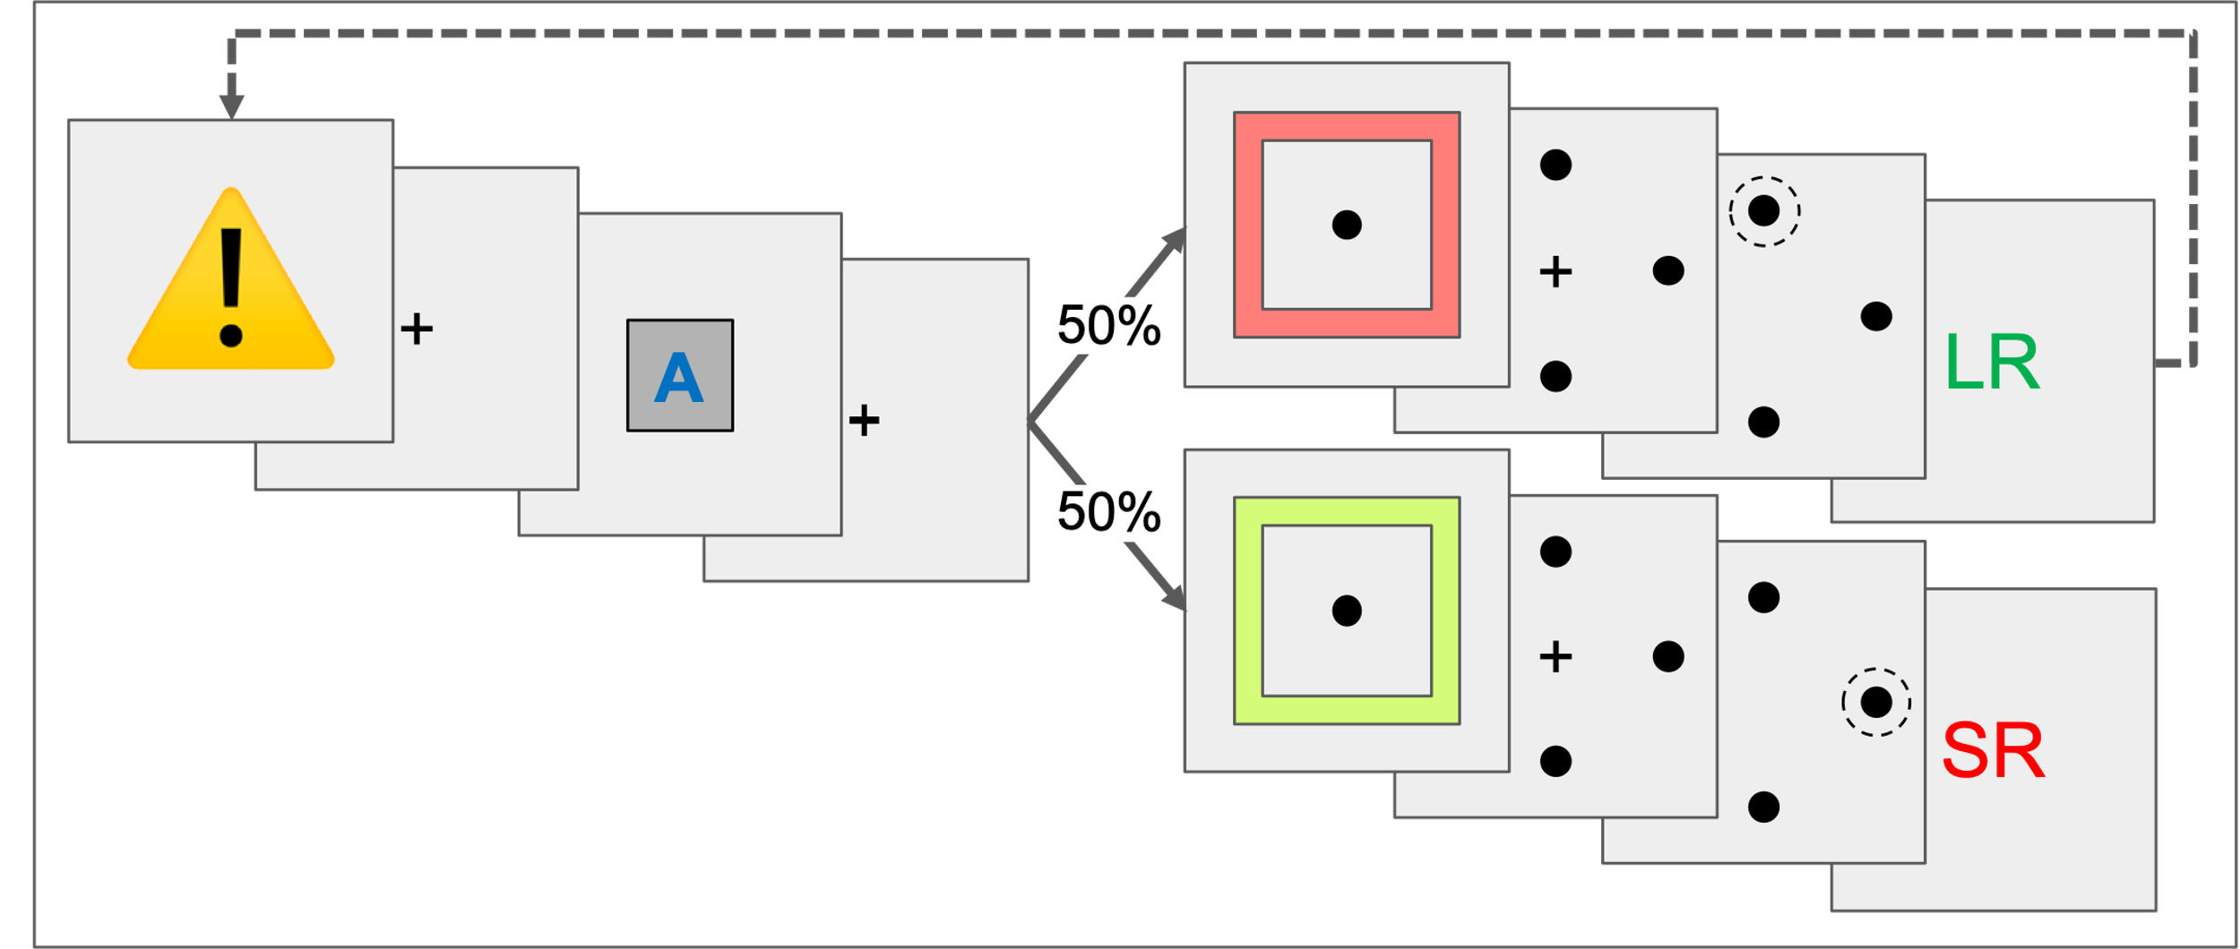
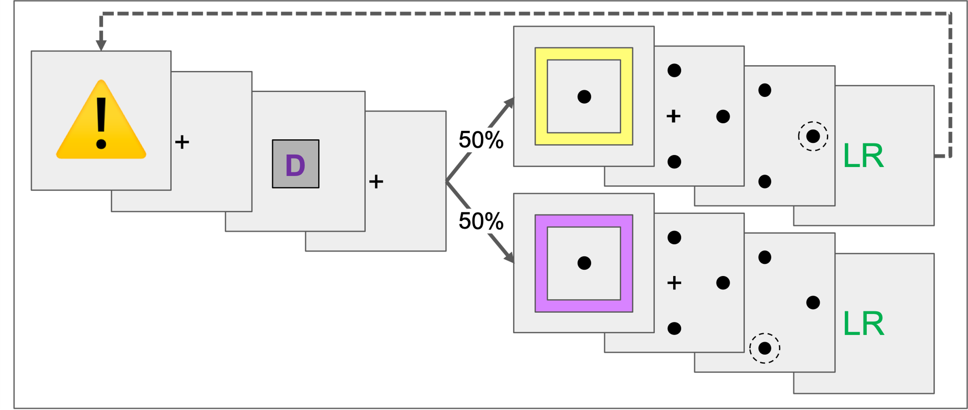
C1 → C2 : Flexibility Trials
C1 → C2 : Generalization Trials

Slide 15
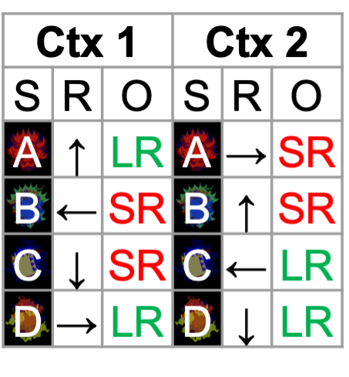
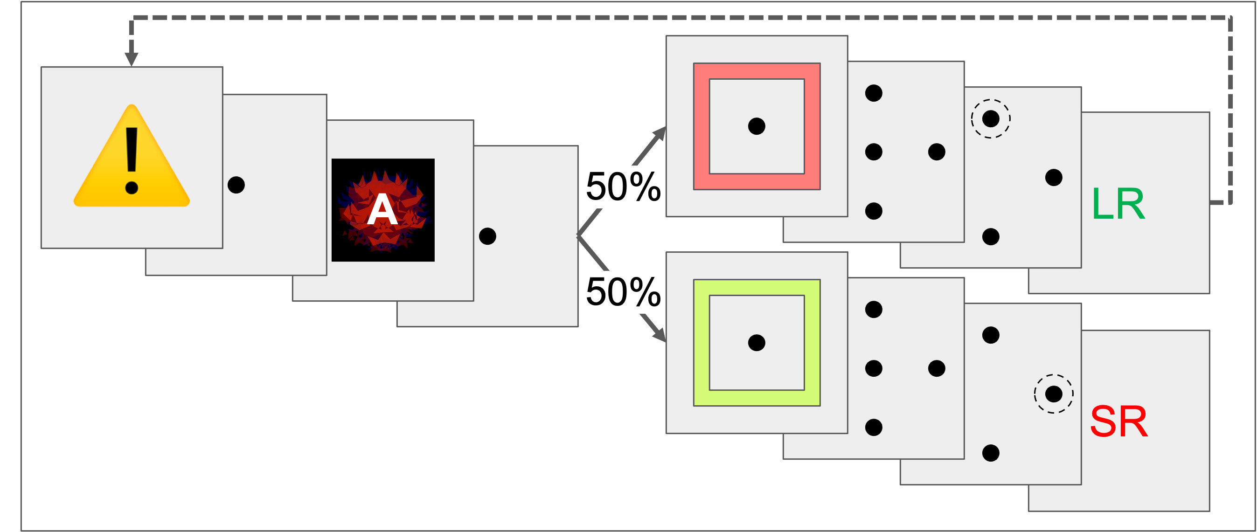
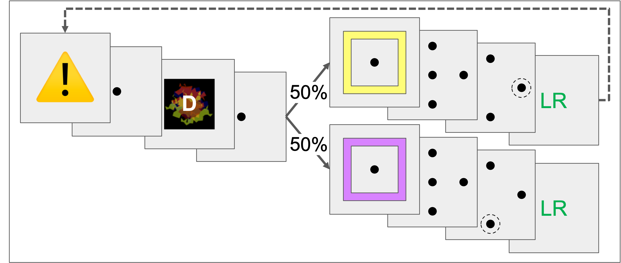
C1 → C2 : Flexibility Trials
C1 → C2 : Generalization Trials

Slide 16
C1 → C2 : Flexibility Trials
C1 → C2 : Generalization Trials

Slide 17
⚠️
…
A
50%
50%
…

Slide 18

⚠️
…
D
50%
50%
…

Slide 19
latent context | C1 | C2 | C1 | C2 | C1 | C2
color = contextual cue letters = stimuli shown | ABCD | ABCD | ABCD | ABCD | ABCD | ABCD
⚠️
50%
A
50%
...

Slide 20
⚠️
…
A
50%
50%
…

Slide 21
⚠️
50%
D
50%
…

